Slide 1
Identifying music features that define rules in classifying musical themes
MENDOZA, Emir Christopher
NUNCIO, Graciel Myka
ONG, Mitchell Bryan
CALIMAG, Fritz Edron
Adviser:
DEJA, Jordan Aiko
Notes:
Emir

Slide 2
Outline
Overview of Technology
Statement of the Problem
Objectives, Scopes & Limitations
Significance of the Study
Theoretical Framework
Methodology
Preliminary Results
Notes:
Emir

Slide 3
MUSIC
Combination of notes
Harmony
Expression

Slide 4
MUSICAL THEMES
MUSIC
THEME
Has the ability to embody themes through expression
An attribute, descriptor, element or concept (Vaismoradi et al., 2016)
Subjective in nature. Difficult to classify music accordingly (Yang & Chen, 2011)
Notes:
Emir

Slide 5
THEMATIC ANALYSIS
Used in music, literature, psychology
Does not have a strict set of rules to follow
Used in qualitative research
(Braun et al., 2019)
Notes:
Emir

Slide 6
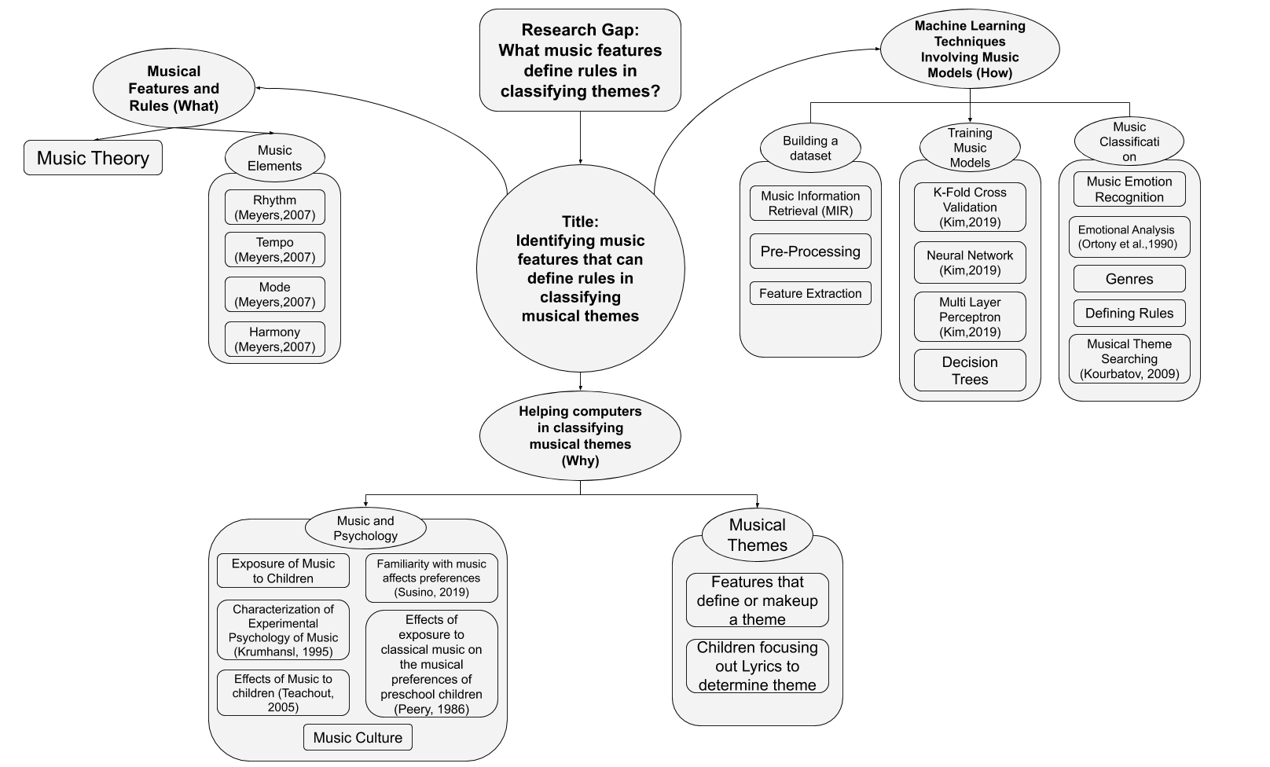
Theoretical Framework : Musical Features and Rules
Notes:
Emir

Slide 7
CLASSIFYING MUSIC
Music Information Retrieval (MIR) -> Features
Music Emotion Recognition (MER) -> Emotions
Notes:
Emir

Slide 8
Classifying music into emotions
(Trohidis, Tsoumakas,Kalliris, & Vlahavas,2008) | Music files of songs from several different genres | 73.19% average accuracy for happy-pleased and average accuracy for relaxing-calm, 87.47%
(Cabredo et al., 2013) | Used EEG with emotion-inducing music | An average relative absolute error of 6.54% using a window length of 38.4 seconds.

Slide 9
CHILDREN’S MUSIC
Building a Model for Music classification in children’s stories using Neural Networks (Kim, 2019)
Gathering different audio samples from videos of Children’s Stories and classifying them into themes.
Notes:
Graciel

Slide 10


Theme
Examples
Cheerful Bravery
Fearful Love
Notes:
Graciel
They embody cheerful and fearful themes

Slide 11
Theoretical Framework : Helping Computers in Classifying Musical Themes
Notes:
Fritz
It is also worth noticing that some of the works are recent yet some of the works are outdated since it's still an ongoing problem that is trying to be solved up to this date

Slide 12
Author | Regression methods | Binary Classification | hierarchical framework for mood detection | K-Fold Cross Validation | Rules?
Yang et al. (2008)
Hu and Downie (2010)
L. Lu, Liu, and Zhang (2006)
Notes:
Checkbox of studies
These are some works that tried to do music classification. The work of yang used regression method *try to mention accuracy*, and another work of Hu and Downie instead of using regression methods used binary classification, both the work yang and hu didn't use a hierarchical framework for mood detection. Interestingly the work of Lu, Liu and Zhang used hierarchical framework for mood detection they achieved *say results*. Since these are all machine learning tasks we were able to note that these studies all used k-fold cross validation for their experiments. In connection to our study or our intended research question we wanted to investigate if there are recent works that attempted to consider or define rules from the results of experiments that deal with music classification since we’ve observed that only few works have tried consider looking onto rules in these types of experiments with the work of yang being one of them.
Yang et al. Formulated MER as a regression problem to predict the arousal and valence values
Hu and Downie Trained a multi-modal mood classifier using both audio and lyric features.
L. Lu, Liu, and Zhang presented a framework for automating the process of detecting moods from acoustic music data using features extracted
These works contributed objective approaches to music classification and could
still be improved mostly in terms of accuracy in classifying, music features used and the range of themes.

Slide 13
Statement of the Problem
With the increasing demand for organization of music information, there are limited studies on rules based on musical features that help computers to objectively classify musical themes.
Notes:
Fritz

Slide 14
General Objective
What music features can be used to define rules in classifying themes?
Notes:
Fritz
for this research, the research question that we aim to answer is *say general objective*

Slide 15
Specific Objective 1
Scope and Limitations
To identify musical features that can be used in the machine learning task in classifying themes
Extracting music samples that embody a specific theme
The themes will be labelled as in reference to Kim (2019)
Cheerful
Brave
Love
Fearful.
The dataset will have at least a total of 400 music samples
Notes:
Fritz
specifically we need to *say 1st specific objective* use connecting words

Slide 16
Specific Objective 2
Scope and Limitations
To build & train multiple machine learning models that will classify music in children's stories into four different themes.
We will use K-fold cross validation
The dataset for the model will be split into 3 parts
Training
Testing
Validation
We will use the experiments done by Kim (2019)
Neural Networks
Decision Trees
Notes:
Fritz The expected question is: How do you split???
We split it by 80% for training
10% Testing and 10% for validation

Slide 17
Specific Objective 3
Scope and Limitations
To derive rules that help in classifying musical themes from the results of the machine learning model.
Musical features that were utilized in trying to derive the rules are limited to low level musical features
Based on the work of Kim (2019) a comprehensive experiment design with at least 3 musical experts will be conducted to validate the correctness and acceptability of the model’s current iteration.
Notes:
Fritz
Low level features such as Spectral Centroid•Spectral Rolloff Point•Spectral Flux•Compactness•Spectral Variability•Root Mean Square•Fraction Of Low Energy Windows•Zero Crossings•Strongest Beat•Beat Sum•Strength Of Strongest Beat•LPC•Method of Moments•Area Method of Moments of MFCCs

Slide 18
Significance of the Study
Educators
Composers
Researchers
Notes:
Graciel

Slide 19
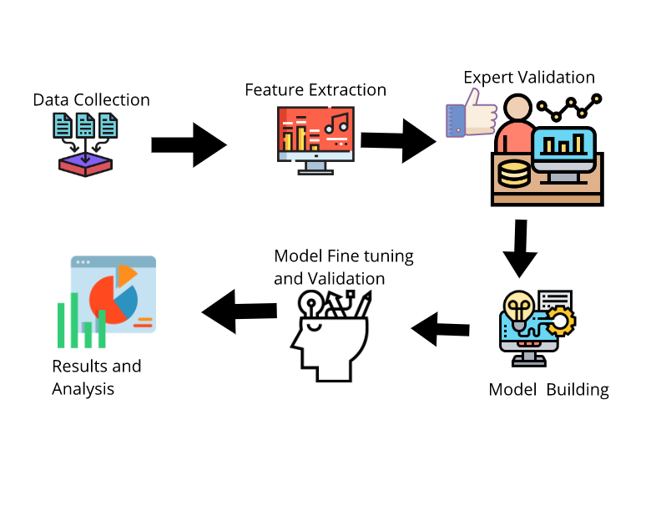
Pipeline
Notes:
Graciel

Slide 20
Theoretical Framework : Machine Learning Techniques Involving Music Models
Notes:
Emir

Slide 21
Theoretical Framework
Notes:
Emir

Slide 22
Preliminary Results
Notes:
Mitch Transition Slide Following the methodology that we have presented earlier this is our Preliminary Results

Slide 23
Dataset Collection
413 samples
57 Tracks from the youtube channel “Chinese Fairy Tales” converted to mp3 then chopped in multiple music segments.
Audacity
4 themes
1 sample = 1 theme

Slide 24
Feature Extraction
JAudio to extract the features
28 features in total
Default Features of JAudio
Notes:
What we did first was that we wanted to extract the default features selected by jAudio
For Today’s proof of concept
In the upcoming models we will be be building, we will be getting from other features based on ranker and based info gain
Spectral Centroid•Spectral Rolloff Point•Spectral Flux•Compactness•Spectral Variability•Root Mean Square•Fraction Of Low Energy Windows•Zero Crossings•Strongest Beat•Beat Sum•Strength Of Strongest Beat•LPC•Method of Moments•Area Method of Moments of MFCCs

Slide 25
Dataset Statistics
Theme Statistics
(In Seconds)
Theme | File Count | Average Time | Longest | Shortest | Standard Deviation
Love | 87 | 17.9 | 63 | 4 | 10.6
Bravery | 50 | 16.2 | 58 | 4 | 10.0
Cheerful | 108 | 17.2 | 65 | 5 | 10.6
Fearful | 168 | 16.9 | 71 | 4 | 9.7

Slide 26
Initial Results
Decision Trees (J48 - Weka) & (Scikit-learn):
 | Weka | Scikit-learn
Instances | 200 | 200
Features | 29 | 29
Correctly Classified Instances | 197 (98.5%) | 195 (97.50%)
Incorrectly Classified Instances | 3(1.5%) | 5 (2.50 %)
Kappa statistics | 0.980 | 0.96
Mean absolute error | 0.007 | 0.02
Root mean squared error | 0.086 | 0.15
Relative absolute error | 2.000% | N/A
Root relative squared error | 20.000% | N/A
Instances | 200
Features | 29
Correctly Classified Instances | 197 (98.5%)
Incorrectly Classified Instances | 3(1.5%)
Kappa statistics | 0.980
Mean absolute error | 0.007
Root mean squared error | 0.086
Relative absolute error | 2.000%
Root relative squared error | 20.000%
Instances | 200
Features | 29
Correctly Classified Instances | 195 (97.50%)
Incorrectly Classified Instances | 5 (2.50 %)
Kappa statistic | 0.96
Mean absolute error | 0.02
Mean square error | 0.02
Root mean squared error | 0.15
Notes:
We’re all doing this because it’s a proof of concept
(We’re telling the panel that it’s doable)

Slide 27
Initial Results
Decision Trees (J48) Confusion Matrix(Weka):
a | b | c | d
49 | 1 | 0 | 0 | a = Bravery
0 | 49 | 1 | 0 | b = Cheerful
0 | 0 | 49 | 1 | c = Fearful
0 | 0 | 0 | 50 | d = Love

Slide 28
Initial Results
Decision Tree Classifier Confusion Matrix (Scikit-learn)
a | b | c | d
11 | 0 | 0 | 0 | a = Bravery
0 | 7 | 0 | 0 | b = Cheerful
0 | 0 | 10 | 0 | c = Fearful
0 | 0 | 1 | 11 | d = Love

Slide 29
Initial Results
Random Forest (Weka) & (Scikit-learn):
 | Weka | Scikit-learn
Instances | 200 | 200
Features | 29 | 29
Correctly Classified Instances | 192 (96%) | 195 (97.50%)
Incorrectly Classified Instances | 8 (4%) | 5 (2.50 %)
Kappa statistics | 0.9 | 0.96
Mean absolute error | 0.1 | 0.02
Root mean squared error | 0.2 | 0.02
Relative absolute error | 42.5% | N/A
Root relative squared error | 49.7% | 0.15
Instances | 200
Features | 29
Correctly Classified Instances | 192 (96%)
Incorrectly Classified Instances | 8 (4%)
Kappa statistics | 0.9
Mean absolute error | 0.1
Root mean squared error | 0.2
Relative absolute error | 42.5%
Root relative squared error | 49.7%
Instances | 200
Features | 29
Correctly Classified Instances | 195 (97.50%)
Incorrectly Classified Instances | 5 (2.50 %)
Kappa statistic | 0.96
Mean absolute error | 0.02
Mean square error | 0.02
Root mean squared error | 0.15

Slide 30
Initial Results
Random Forests Confusion Matrix(Weka)
a | b | c | d
48 | 2 | 0 | 0 | a = Bravery
0 | 48 | 2 | 0 | b = Cheerful
0 | 0 | 49 | 1 | c = Fearful
0 | 0 | 3 | 47 | d = Love

Slide 31
Initial Results
Random Forest Classifier Confusion Matrix (Scikit-learn)
a | b | c | d
11 | 0 | 0 | 0 | a = Bravery
1 | 6 | 0 | 0 | b = Cheerful
0 | 0 | 10 | 0 | c = Fearful
0 | 0 | 0 | 12 | d = Love

Slide 32
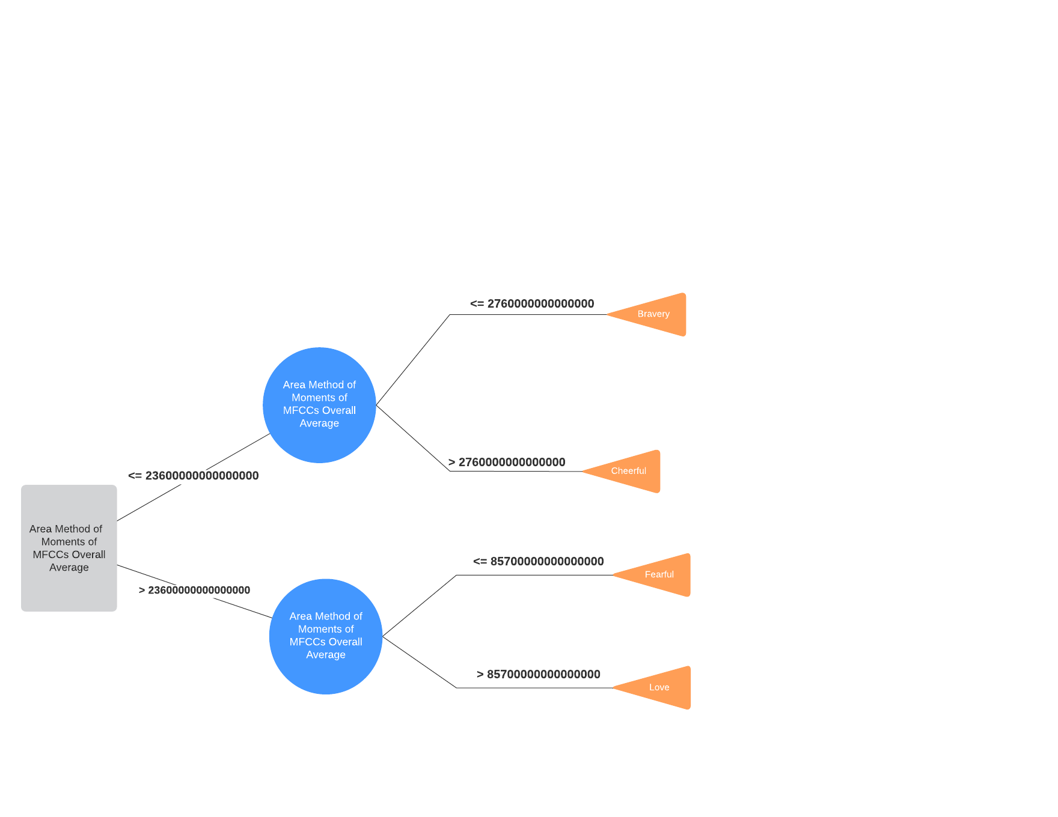
J48 Decision Tree(Weka)

Slide 33
Proof of Concept | Thesis
Weka | Softmax Classification
Scikit-learn | Neural Network Model
 | Xavier
 | Deep Neural Network
 | Dropout
 | Adam Optimizer

Slide 34
Decision Tree Classifier(Scikit-learn)
Instances | 200
Features | 29
Correctly Classified Instances | 195 (97.50%)
Incorrectly Classified Instances | 5 (2.50 %)
Kappa statistic | 0.96
Mean absolute error | 0.02
Mean square error | 0.02
Root mean squared error | 0.15
Instances | 200
Features | 29
Correctly Classified Instances | 195 (97.50%)
Incorrectly Classified Instances | 5 (2.50 %)
Kappa statistic | 0.96
Mean absolute error | 0.02
Mean square error | 0.02
Root mean squared error | 0.15

Slide 35
Random Forest Classifier(Scikit-learn)
Instances | 200
Features | 29
Correctly Classified Instances | 195 (97.50%)
Incorrectly Classified Instances | 5 (2.50 %)
Kappa statistic | 0.96
Mean absolute error | 0.02
Mean square error | 0.02
Root mean squared error | 0.15

Slide 36
End of Presentation

Slide 37
Question & Answer

